Slide 1

You will need a email account with Microsoft Passport supported
Create a new Office 365 Tenant
https://developer.microsoft.com/en-us/office/dev-program

Slide 2

Notes:
Create a new Office 365 Development Tenant
1 year up to 25 users

Slide 3

DEMONTRATION
You will need a email account with Microsoft Passport supported
Create the tenant
Create AppCatalog
https://developer.microsoft.com/en-us/office/dev-program

Slide 4
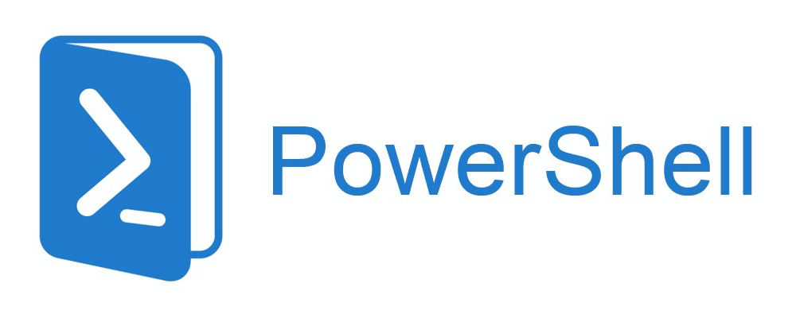
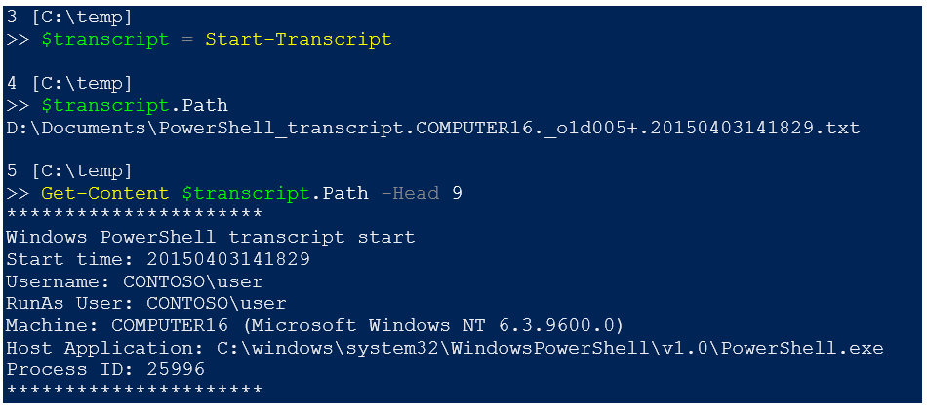
Windows PowerShell
Windows PowerShell is a shell for task automation and configuration management
Already installed in Windows
Strong language support and default on many products

Slide 5
Windows PowerShell
Commands to remember
Set-ExecutionPolicy RemoteSigned
cd\
md newdirectoryname
cd newdirectoryname

Slide 6

Demo
Create project folder structure

Slide 7
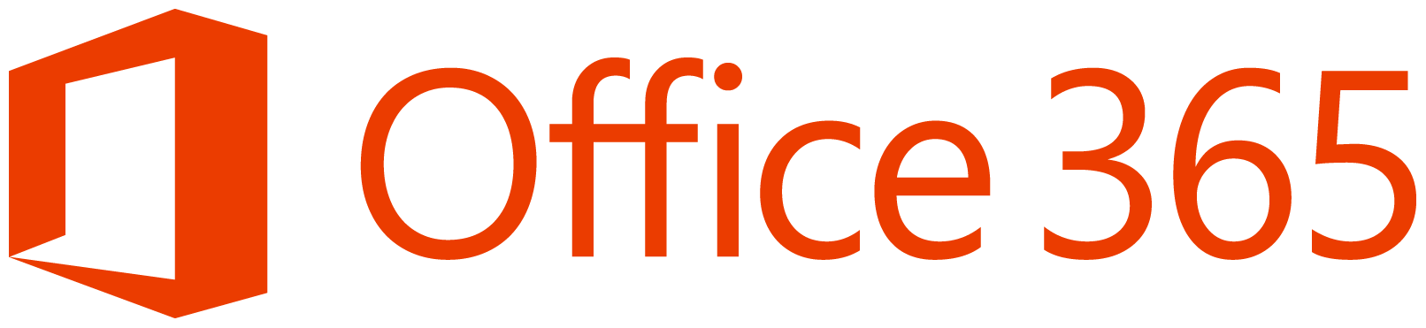
Office 365 Management Shell
PowerShell commands to manage your Office 365 Tenant
Download SharePoint Online Management Shell in order to install command lets

Slide 8
Office 365 Management Shell
Commands to remember:
$cred = Get-Credential -UserName admin@ps56us.onmicrosoft.com -Message "Type the password."
Connect-SPOService -Url https://ps56us-admin.sharepoint.com -Credential $cred
Remove-SPOSite -Identity https://ps54us.sharepoint.com/sites/portal
Get-SPODeletedSite | Remove-SPODeletedSite

Slide 9
Demo
Download and install SharePoint Online Management Shell
https://www.microsoft.com/en-us/download/details.aspx?id=35588

Slide 10

SharePoint PnP PowerShell Online
PowerShell commands that allows you to perform complex provisioning and artifact management actions towards SharePoint. The commands use a combination of CSOM and REST behind the scenes, and can work against both SharePoint Online as SharePoint On-Premises.

Slide 11
SharePoint PnP PowerShell Online
Commands to remember
Set-ExecutionPolicy RemoteSigned
Install-Module SharePointPnPPowerShellOnline
Update-Module SharePointPnPPowerShell*
Get-Module SharePointPnPPowerShell* -ListAvailable | Select-Object Name,Version | Sort-Object Version -Descending
Pre-requisite install Windows Management Framework v4.0
http://www.microsoft.com/en-us/download/details.aspx?id=40855

Slide 12

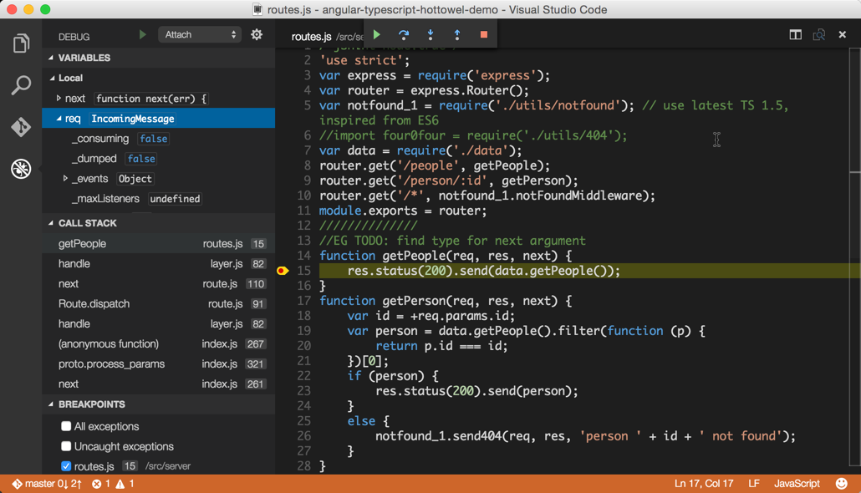
Visual Studio Code
https://code.visualstudio.com/
Code editor optimized for building modern web and cloud applications
No cost
Support intellisense
Support debugging
Support extensions
Multiple platforms

Slide 13
Visual Studio Code
https://code.visualstudio.com/
Commands to remember
Navigate to your code folder using command line editor
code .

Slide 14
Demo
Download and install from https://code.visualstudio.com/

Slide 15

GitHub
https://github.com/
https://git-scm.com/
Git is a free and open source distributed version control system designed to handle everything from small to very large projects with speed and efficiency.
Create code repositories
Follow authors
Fork codebases and extend code
Clone code repositories

Slide 16
GitHub
Git Command-line tools
https://github.com/
https://git-scm.com/
Commands to remember
git clone https://github.com/SPDoctor/Glossary.git
git clone https://github.com/helpdsp/spfx-week.git

Slide 17
Demo
Download and install Git command line tools https://git-scm.com/download/win

Slide 18




Open Source Tooling
Tools
Node.js
Yeoman
Gulp
Typescript
Visual Studio (Code)
PowerShell
Git
Frameworks
React
Angular.js
Knockout
Etc.
Notes:
SharePoint will also support open source tooling to drive greater efficiencies when developing Parts and Apps. These tools should not be considered a replacement of an organizations traditional tools, but rather an extension of those, providing new opportunities to quickly get up and running with SharePoint development. If you’re familiar with Visual Studio development with SharePoint, this tools carry a lot of similarities with the tools you may already be familiar with for example:
Yeoman provides a generator ecosystem. A generator is basically a plugin that can be run with the `yo` command to scaffold complete projects or useful parts.
yo scaffolds out a new application, writing your build configuration (e.g Gruntfile, Gulpfile) and pulling in relevant build tasks and package manager dependencies (Bower, npm) that you might need for your build. This is similar to Project Scaffolding in Visual Studio.
Gulp
Automation - gulp is a toolkit that helps you automate painful or time-consuming tasks in your development workflow.
Platform-agnostic - Integrations are built into all major IDEs and people are using gulp with PHP, .NET, Node.js, Java, and other platforms.
Strong Ecosystem - Use npm modules to do anything you want + over 2000 curated plugins for streaming file transformations
Simple - By providing only a minimal API surface, gulp is easy to learn and simple to use
Node.js® is a JavaScript runtime built on Chrome's V8 JavaScript engine. Node.js uses an event-driven, non-blocking I/O model that makes it lightweight and efficient. Node.js' package ecosystem, npm, is the largest ecosystem of open source libraries in the world.
event driven JavaScript runtime, Node is designed to build scalable network applications similar to
VS SharePoint development: Gulp = MSBuild, NodeJS = IIS (Express), YeoMan = project scafolding in VS, TypeScript= typed superset of JavaScript

Slide 19



Comparing tools with MS
IIS Express
MS Build
VS Project →
New → <Template>
C#

Slide 20
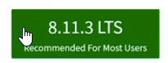
Node.js – Open-source, cross-platform JavaScript runtime environment
https://nodejs.org/en/
JavaScript runtime environment that can work locally
Allows us to build JavaScript applications that run outside the scope of the browser which means you could run JavaScript either locally on your laptop or in a large cluster on the Cloud
Allows the creation of Web servers to run server side code
Node.js works across platforms. It is lightweight, fast and the node package manager, npm, gives us access to the largest source of open source libraries in the world.
LTS stands for Long Term Support

Slide 21
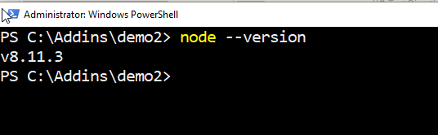
Node.js – Open-source, cross-platform JavaScript runtime environment
https://nodejs.org/en/
Commands to remember
Node –version

Slide 22
Demo
Download and install from https://nodejs.org/download/release/v8.11.3/

Slide 23
npm – Node Package Manager
> npm install typescript --save-dev
https://www.npmjs.com/
NPM is a NodeJS package manager, you can use it to install node programs
Similar a NUGET.
Command line utility to install Node.js packages, do version management and dependency management of Node.js packages.

Slide 24
npm – Node Package Manager
> npm install typescript --save-dev
https://www.npmjs.com/
Commands to remember
Install SharePoint Framework and Office Add Ins dev tools
npm install --global --production windows-build-tools
npm install –g yo
npm i -g yo gulp
npm i -g @microsoft/generator-sharepoint
npm install –g generator-office
npm install
npm start

Slide 25
Yeoman – Project Templates
> yo office
http://yeoman.io
Code generation tool for development projects
You can install it using NPM commands
There is a Microsoft Yeoman generator for Office Add Ins that allow quickly set up a new client-side web part project – office
There is a Microsoft Yeoman generator for SharePoint Framework that allow quickly set up a new client-side web part project - @microsoft/generator-sharepoint

Slide 26
Yeoman – Project Templates
> yo office
http://yeoman.io
Commands to remember, using Yeoman templates for SPFx and Office Add Ins
Yo
Yo office
Yo @Microsoft/sharepoint

Slide 27
Demo
Create SharePoint Framework Web Part
Create Office Add In

Slide 28
gulp – Build process manager
> gulp serve
http://gulpjs.com/
Gulp is a JavaScript task runner that lets you automate tasks
Similar a MS Build.
Support automatic recompilation as your save code files

Slide 29
gulp – Build process manager
> gulp serve
http://gulpjs.com/
Commands to remember
gulp serve
gulp bundle --ship
gulp package-solution --ship

Slide 30
Typescript – Typed JavaScript
> tsc
https://www.typescriptlang.org/
Typescript is a typed superset of JavaScript that compiles to pure JavaScript
Allows enterprise developers to create better JavaScript-intensive applications by introducing variable typing, classes and modules

Slide 31
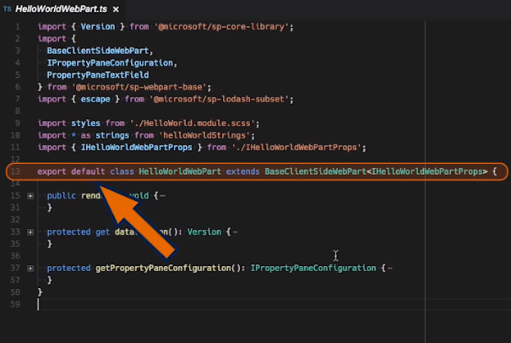
Typescript – Typed JavaScript
> tsc
https://www.typescriptlang.org/
This to remember:
Imports
class definition
Methods

Slide 32
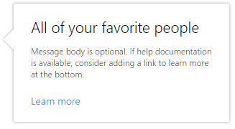
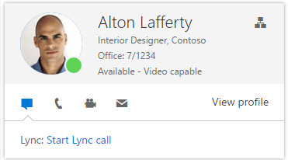
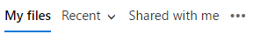
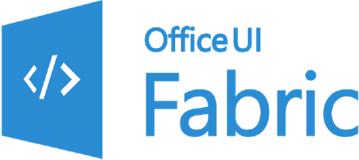
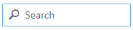
Office UI Fabric – UI for SharePoint
http://dev.office.com/fabric
Office UI Fabric is a responsive, mobile-first, front-end framework for developers, designed to make it simple to quickly create web experiences using the Office Design Language
Office IU Fabric is supported in SharePoint

Slide 33
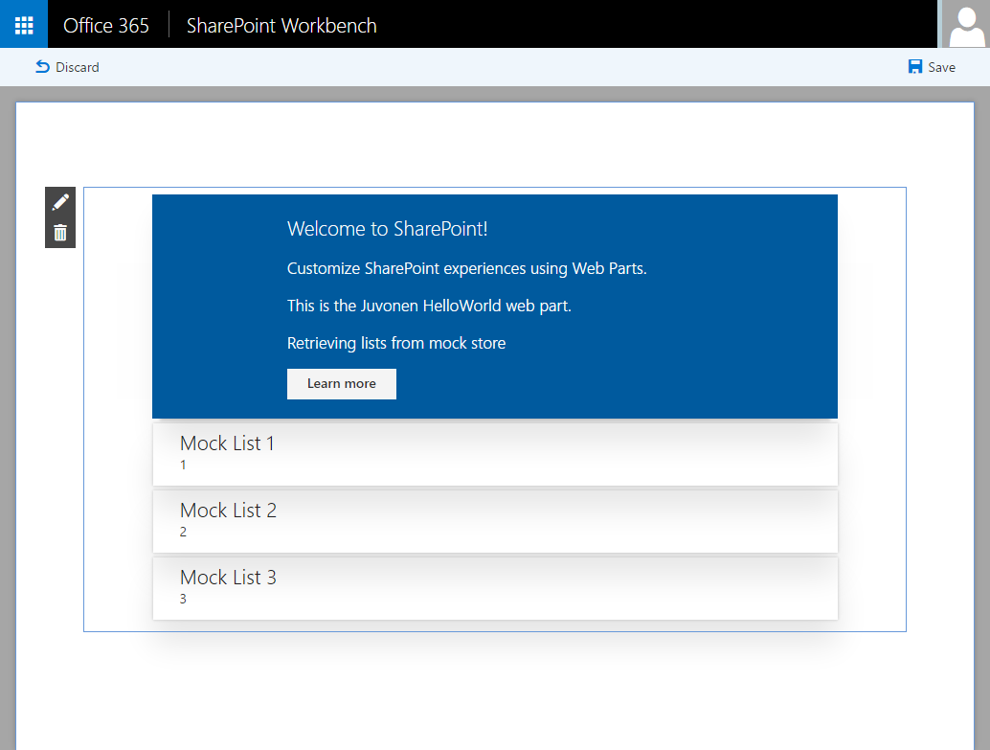
SharePoint Workbench
Local development time experience
Test your changes immediately even in offline mode

Slide 34
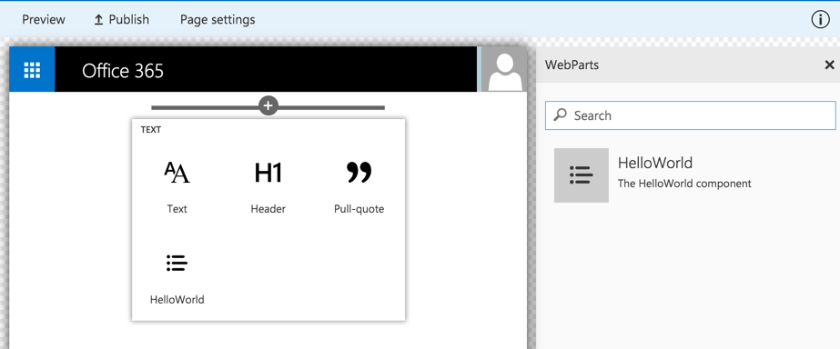
Client-side Web Part Build Flow
nap install generator-sharepoint -g
gulp serve
gulp package-solution
Install SharePoint Generator
Test
Package/Deploy
yo sharepoint
workbench
gulp upload-cdn
Scaffold SharePoint Web Part Project
Local
Package/Deploy
Code
manual upload of the app
Build Web Part Code
UAT / Pre-production
Release using app catalog*
Ship?
Available on Classic and Client-Side Pages

Slide 35
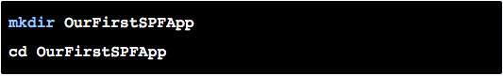
Our first SPFx web part

Slide 36
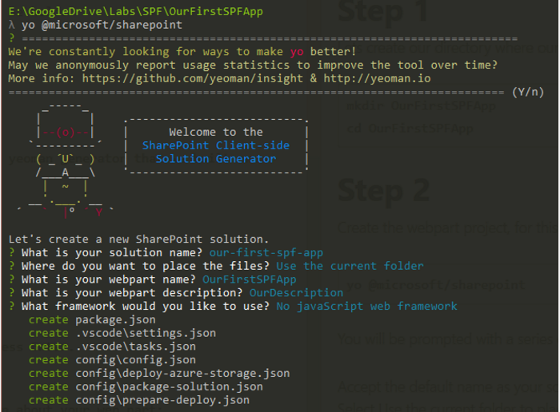
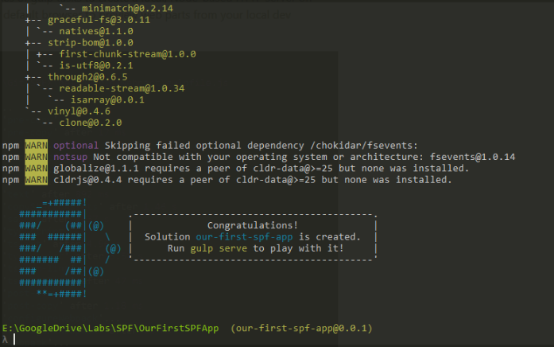
Our first SPFx web part

Slide 37
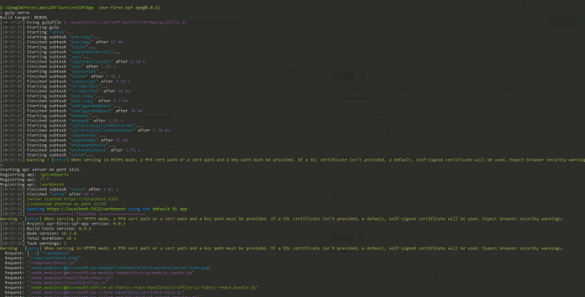
Our first SPFx web part

Slide 38

Property Pane

Slide 39
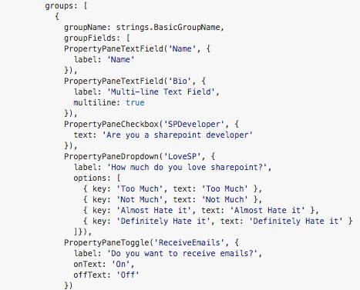
Controls supported in the property pane
Simple and dynamic property pane fields
Lots of controls to simplify data entry
For example:
Text Boxes
Check Boxes
Drop Down
Toggle

Slide 40
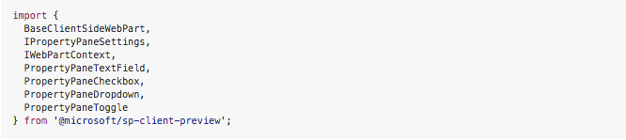
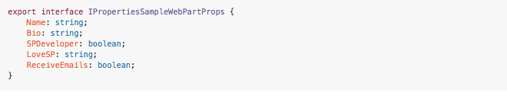
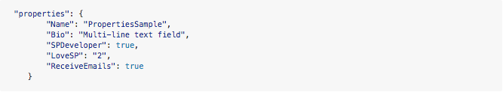
Controls supported in the property pane
1. Import the controls we need MyDemoSPFx.ts
2. Define the data structure of our property pane IMyDemoSPFxWebPartProps.ts
3. Optionally define default data in MyDemoSPFxWebpart.manifest.json

Slide 41
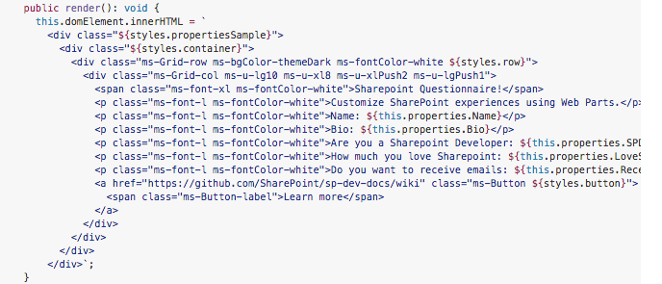
Controls supported in the property pane

